Slide 1
Notes:
REMARKS
Thank you for your time today. It’s been a pleasure sharing with you how P&G’s focus on innovation, values and talent is experienced through the lives of students and interns.
We hope that you will join us as we continue down our path of constructive disruption.

Slide 2
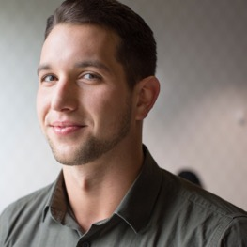
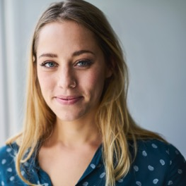
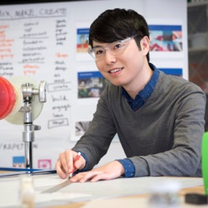
LEAD FROM DAY 1
Notes:
REMARKS
Fundamental to our ability to stay relevant is our people.
Every employee whether an Intern, plant manager, engineer or marketer are trusted to lead from Day 1.
We take leadership seriously and when you decide to work for us, you are making a commitment to your own development that will serve you in work and in life.
As students, you’ve made a significant investment in your education.
Choosing an employer whose culture helps coach, develop and mentor you with a fast-paced career progression is the greatest ROI (return on investment) you can get in the early stages of your career.
We give you experience starting Day 1 that builds your c-suite potential through real decision-making authority.
We provide frequent opportunities for talent to move across brands and geographies to tackle new challenges.
We also provide you with the mentorship and support needed to balance personal growth and professional development. We take care of you so you can take care of business.
When you choose P&G as your employer, you are trusted to lead and committing to relentless improvement in your work and in yourself.

Slide 3
WE ARE P&G
A COMPANY OF LEADING BRANDS
Notes:
REMARKS
That was fun!
The truth is your experience at P&G connects you to these remarkable brands. Every day you get to make impact in how consumers experience our brands.
We are a company of leading brands...

